Slide 1

Feature Extraction and Price Prediction for Mobile Phones
NextHikes IT Solutions begins
Riddhima Maheshwari

Slide 2

Dataset Overview
The dataset contains 541 mobile records and 12 features.
Feature types:
6 categorical (e.g., Model, Colour)
5 integer (e.g., RAM, Memory)
1 float (e.g., Mobile Height)
Key features include:
Model, Color, Memory, RAM
Rear & Front Camera, AI Lens
Battery capacity and dimensions

Slide 3
Data Preprocessing Steps
1.Removed unnecessary columns-
Dropped unnamed index or ID columns.
2.Checked and confirmed no missing values-
All 541 rows are complete with no nulls.
3.Converted categorical features using One-Hot Encoding-
Applied pd.get_dummies() with drop_first=True to avoid multicollinearity.
4.Scaled numerical features (optional for linear models)-
Used StandardScaler() for models that require normalization.
5.Split the data-
Performed 70-30 Train-Test split using train_test_split().

Slide 4
Outlier Detection
Used IQR (Interquartile Range) method on all numeric columns.
Formula: Outlier = value < Q1 - 1.5×IQR or value > Q3 + 1.5×IQR
Outliers were mainly found in battery, memory, and design columns. Capping them preserved model integrity while removing distortions from extreme values.

Slide 5
Feature Engineering
Key Features Created:
Total_Camera_MP = Rear + Front camera megapixels
Gives a unified measure of overall camera quality.
Total_Memory_GB = Memory + RAM
Represents total storage capacity perceived by users.
Battery_Height_Ratio = Battery / Mobile Height
Indicates battery density per phone size.
Rear_Camera_per_GB_RAM = Rear Camera / RAM
Balances camera strength with performance capacity.
Battery_Category & Memory_Category
Binned features like Small/Medium/Large for better interpretability.

Slide 6
Redundant Feature Removal
Action Taken:
Dropped original string-based camera columns:
'Rear Camera'
'Front Camera'
Reason:
We had already extracted their numeric values (Rear_Camera_MP, Front_Camera_MP)
Also created combined features like Total_Camera_MP

Slide 7
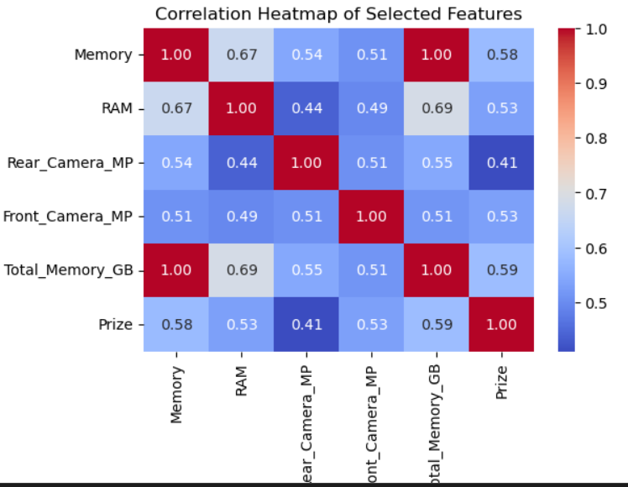
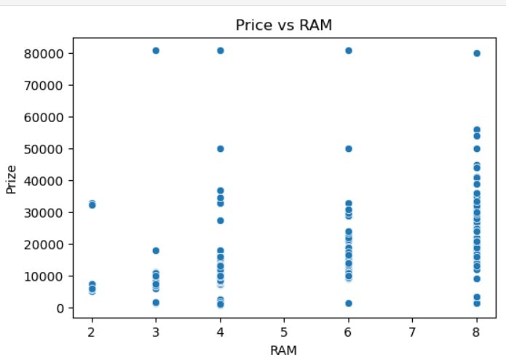
Data Visualization
Correlation Heatmap:
Total_Memory_GB shows the strongest correlation with Price (0.59)
RAM and Front_Camera_MP also have moderate positive influence
Rear camera has a weaker correlation with price
Scatter Plots:
Price vs Total Memory:
Devices with higher total memory tend to cost more, indicating strong influence.
Price vs RAM:
More RAM slightly increases price, but trend is weaker than total memory.

Slide 8
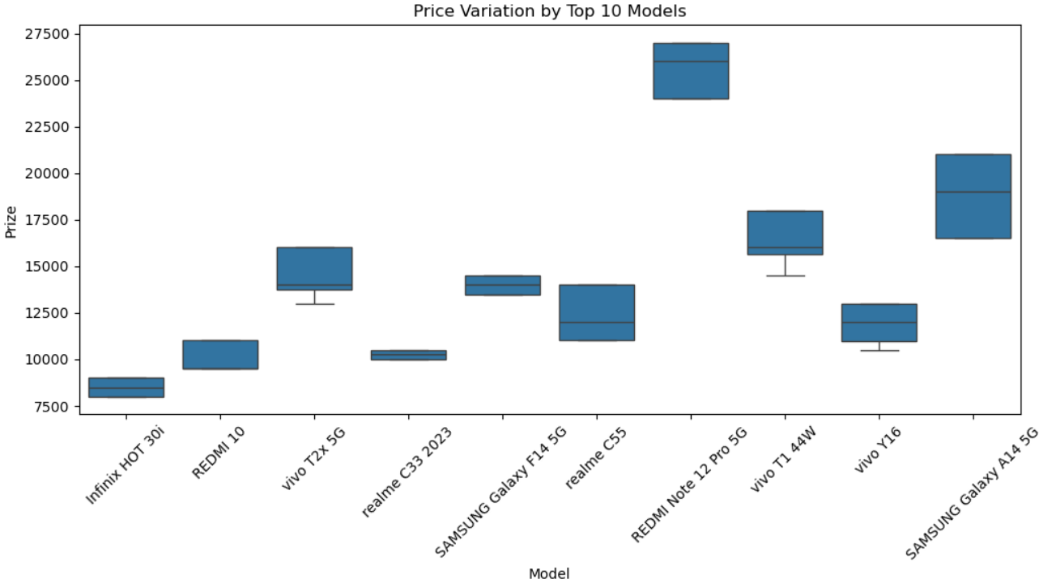
Data Visualization
Boxplot – Price by Model:
iPhone 14 Plus model has the highest price range
Infinix HOT 30i shows the lowest price range
Some models (like Realme or Samsung) show wide variance, suggesting multiple variants.

Slide 9
Model Building & Evaluation
Imported libraries (pandas, NumPy, sklearn, matplotlib).
One-hot encoded categorical columns.
Split data into training (70%) and testing (30%).
Trained Random Forest Regressor on training set.
Evaluated using:
MAE ≈ 2492
RMSE ≈ 5590
R² Score ≈ 0.67 (67% accuracy)

Slide 10
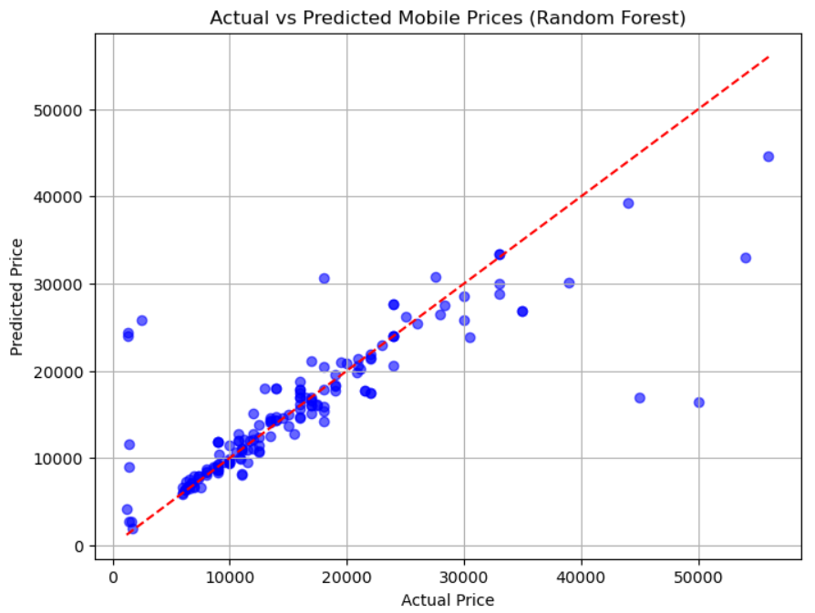
Prediction & Visualization
Sample Predictions:
Predicted: [17738, 20489, 10639, 6820, 6321]
Actual: [18999, 17999, 12499, 6499, 6199]
Scatter Plot Insight:
Points close to red line → good prediction.
Minor errors in higher price range.
Overall, model performs reasonably well.

Slide 11
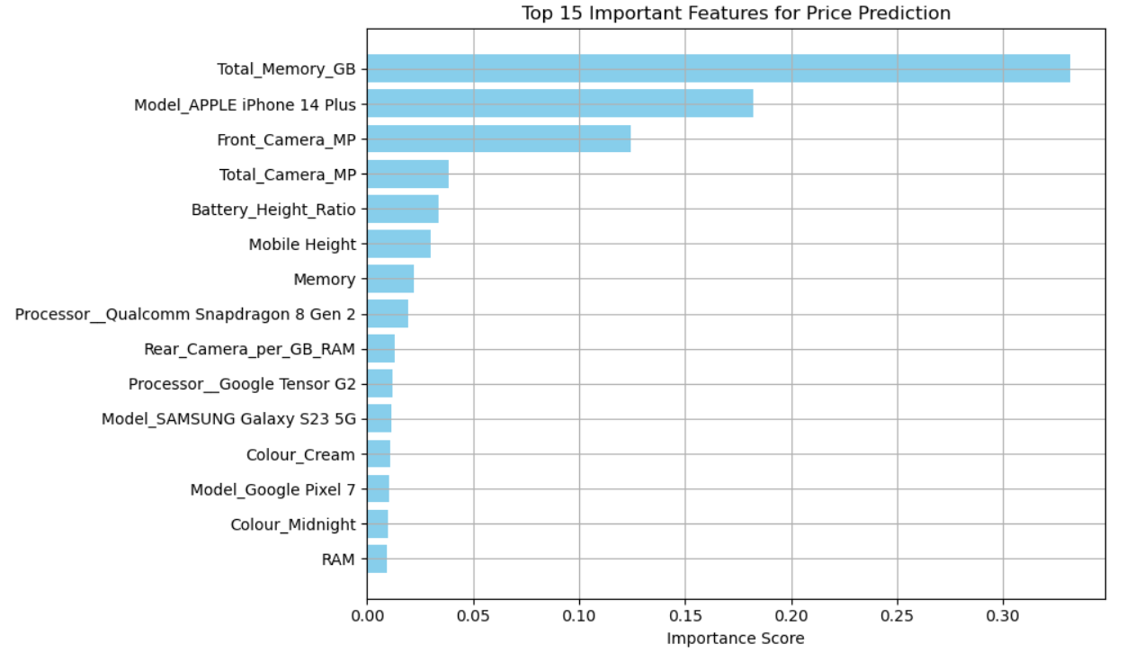
Feature Importance Analysis
Objective:
Identify which features most influence mobile price predictions.
Key Insights:
Total_Memory_GB is the strongest predictor of price.
Brand (e.g., iPhone 14 Plus) and Front_Camera_MP also play major roles.
Features like RAM and Colour have surprisingly low individual impact.

Slide 12
Feature Importance Analysis
Rank | Feature | Importance Score
1 | Total_Memory_GB | 0.33
2 | Model_APPLE iPhone 14 Plus | 0.18
3 | Front_Camera_MP | 0.12
4 | Total_Camera_MP | 0.08
5 | Battery_Height_Ratio | 0.03

Slide 13

References
https://domino.ai/data-science-dictionary/feature-extraction
https://www.geeksforgeeks.org/what-is-feature-engineering/

Slide 14

Thank you!

